Slide 1
NCJIS Modernization Program Update for the NCJIS Advisory Committee
Tuesday, September 29, 2015
Linda Kennedy
NCJIS Modernization Program Manager

Slide 2
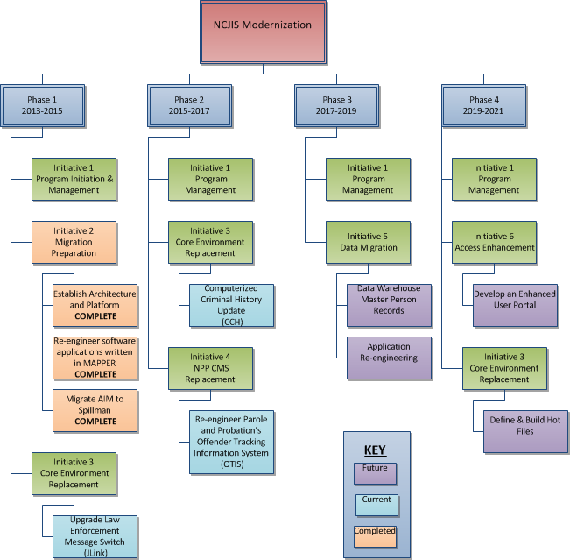

Slide 3
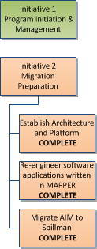
Completed Projects
Establish Architecture and Platform
SAG webMethods Implemented
SAG webMethods Training
Docs and Images Pilot
Re-engineer software applications written in MAPPER
Application used by Parole and Probation rewritten
.NET Restitution
Migrate AIM to Spillman
All data for Investigations entered into Spillman

Slide 4
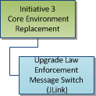
Completed Project
Jlink Architecture upgrade as scheduled
In Progress Project
Software Upgrade Law Enforcement Message Switch (Jlink)
Initial code completed by NorSoft
Initial test completed by EITS on schedule
Detailed configuration underway by EITS
Detailed testing underway by EITS
User testing planned to begin in January

Slide 5
In Progress Projects
Both CCH and OTIS
Funded by the 2015 legislature
Requirements completed by Business Process Analysts on schedule
Requirements reviewed and enhanced by EITS on schedule
Six Master Service Agreement (MSA) contractor programmers added to team on schedule
Joint Application Design (JAD) sessions are underway

Slide 6
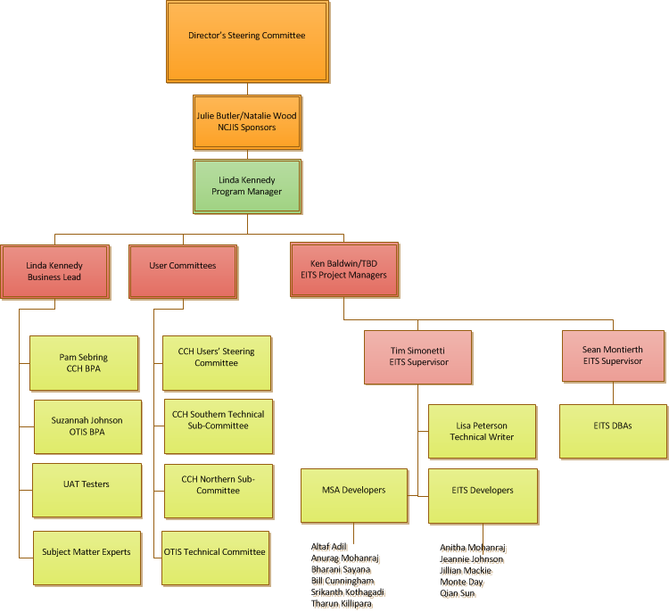
Phase 2 Program Organization

Slide 7
Current Schedule

Slide 8
Questions

